Slide 1
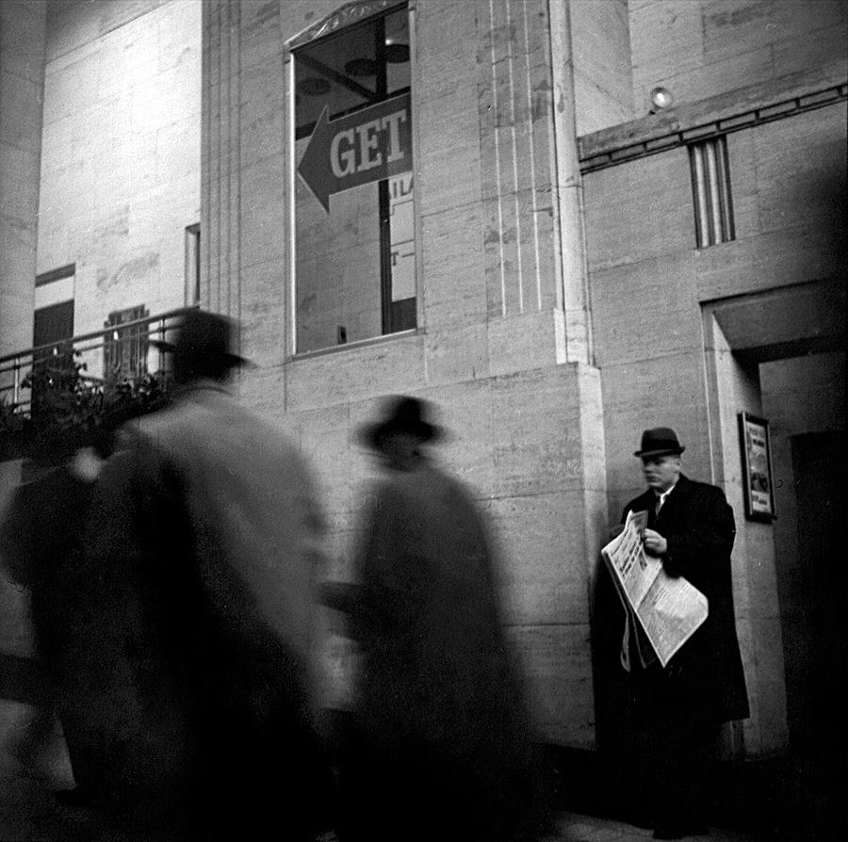
I. Warm-up: “Love Letter” (again). Gez Walsh.
II. Clothing / Accessories
A. need / want / would like (to get)
What’s (s)he wearing? Practice for evaluation Friday (describing what people are wearing)
(s)he’s wearing …
/ ʃiz'werɪŋ /
/ hiz'werɪŋ /
they’re wearing …
US: / ðer'werɪŋ /
UK: / ðeə'weərɪŋ /

Slide 2
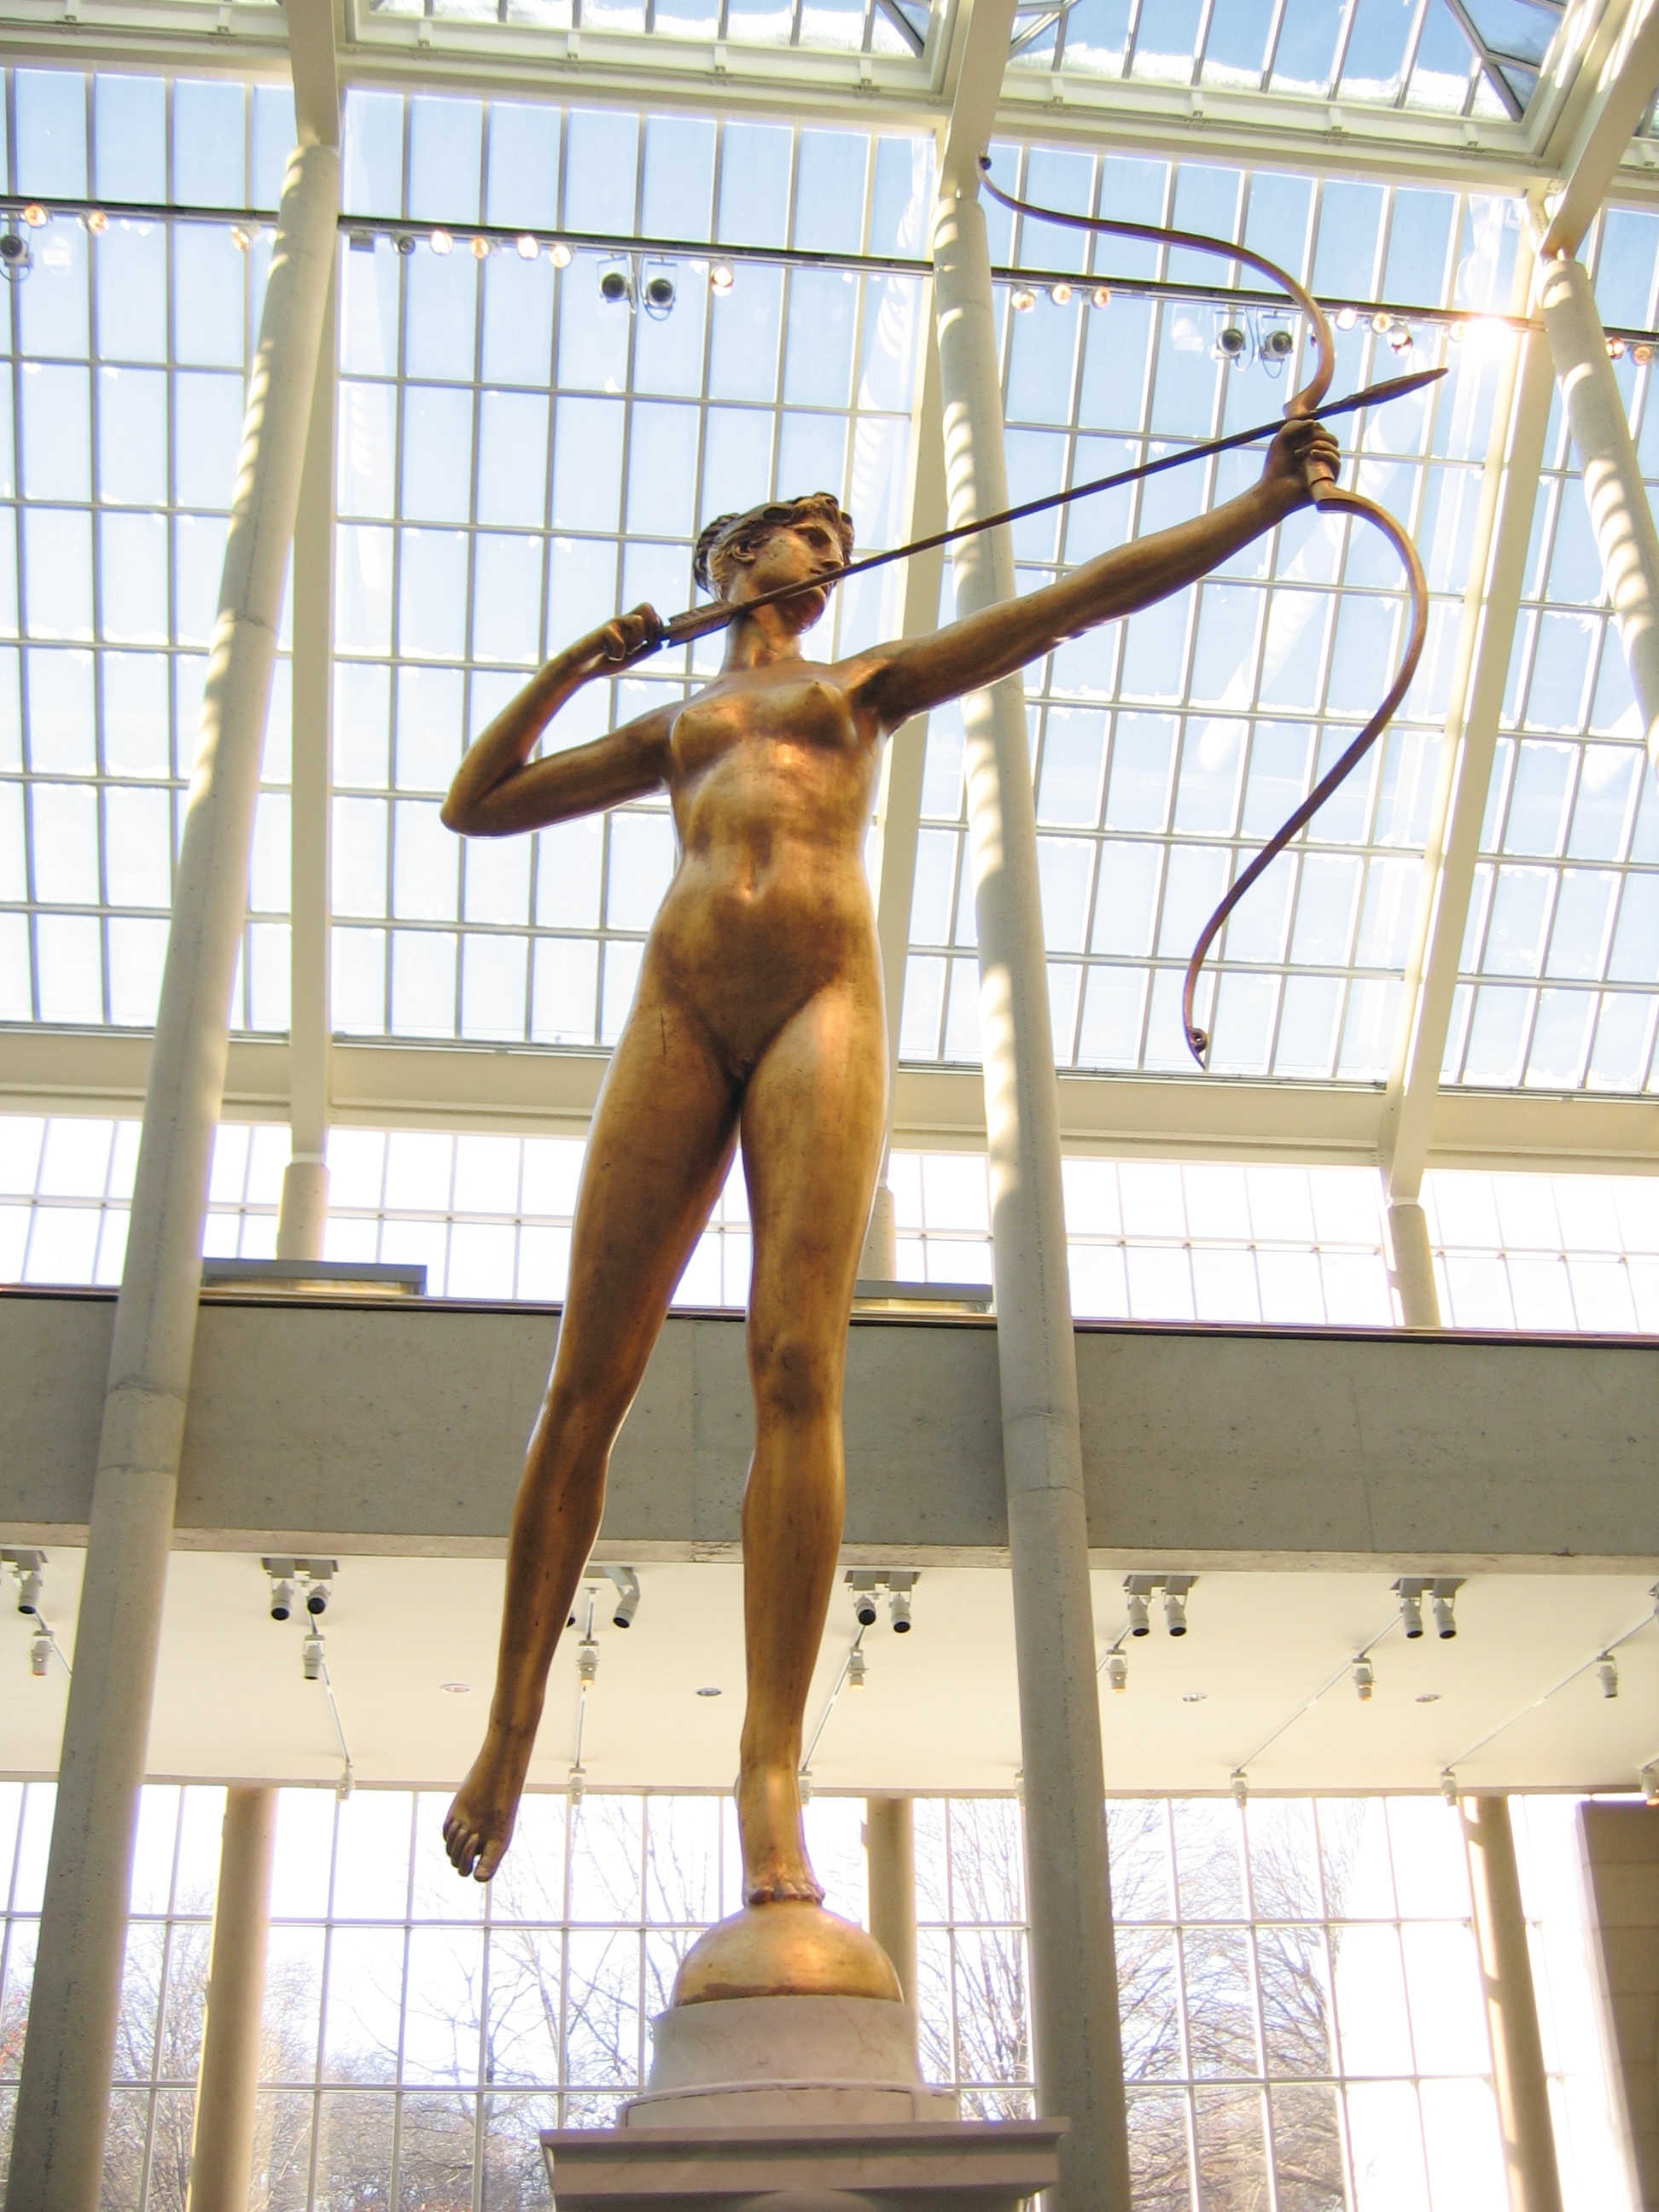
Warm-up.
I s e n t Susan a letter.
s a y ing how I f e e l
I t o l d her that I l o v e d her
And that my love w a s real.

Slide 3
Love Letter
I s _ _ _ Susan a letter.
s _ _ ing how I f _ _ _
I t _ _ _ her that I l _ _ _ d her
And that my love w _ _ real.

Slide 4
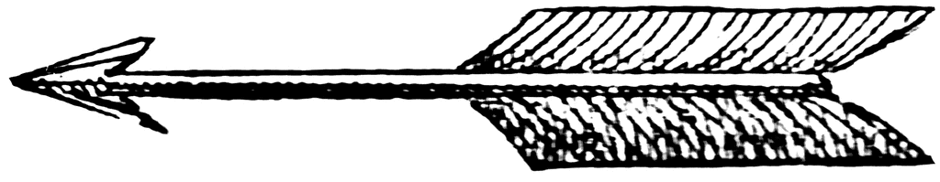
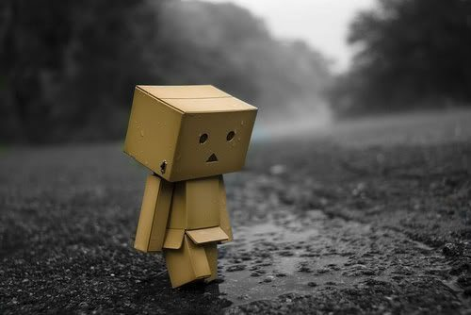
Warm-UP
I s a i d that if she l o v e d me.
She only h a d to s a y
But she s e n t me b a c k my letter,
s a y ing, “Just g o away.”

Slide 5
Love Letter
I s _ _ _ that if she l _ _ _ d me.
She only h _ _ to s _ _
But she s _ _ _ me b a _ _ my letter,
S _ _ing, “Just g _ away.”

Slide 6
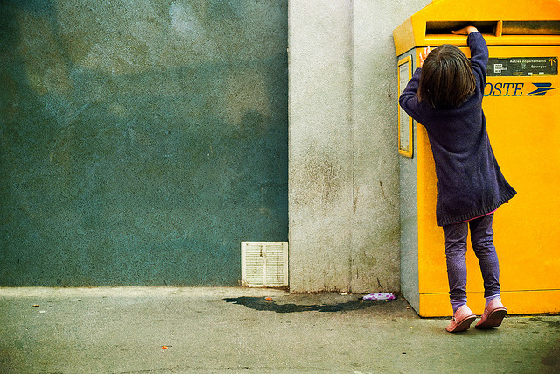
What’s she doing?
S h e ’ s _ _ _ _ i n g a l _ _ _ _ _.
S h e ’ s s e n d i n g a l e t t e r.
S h e ’ s m a i l i n g a l e t t e r.
S h e ’ s p o s t i n g a l e t t e r.

Slide 7
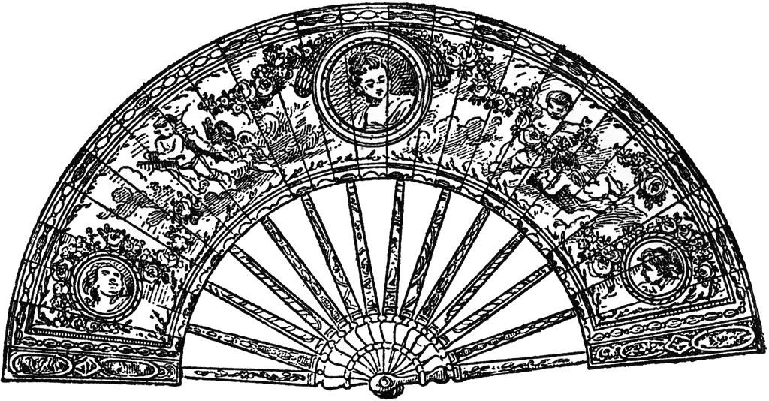
Can I borrow your fan?
Clothing and accessories in English

Slide 8
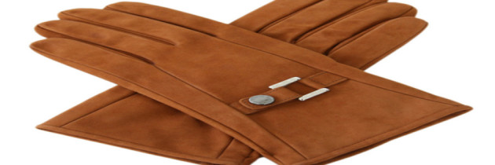
I need ( to get )…
  plastic gloves
  silk gloves
  leather gloves
  wool mittens

Slide 9
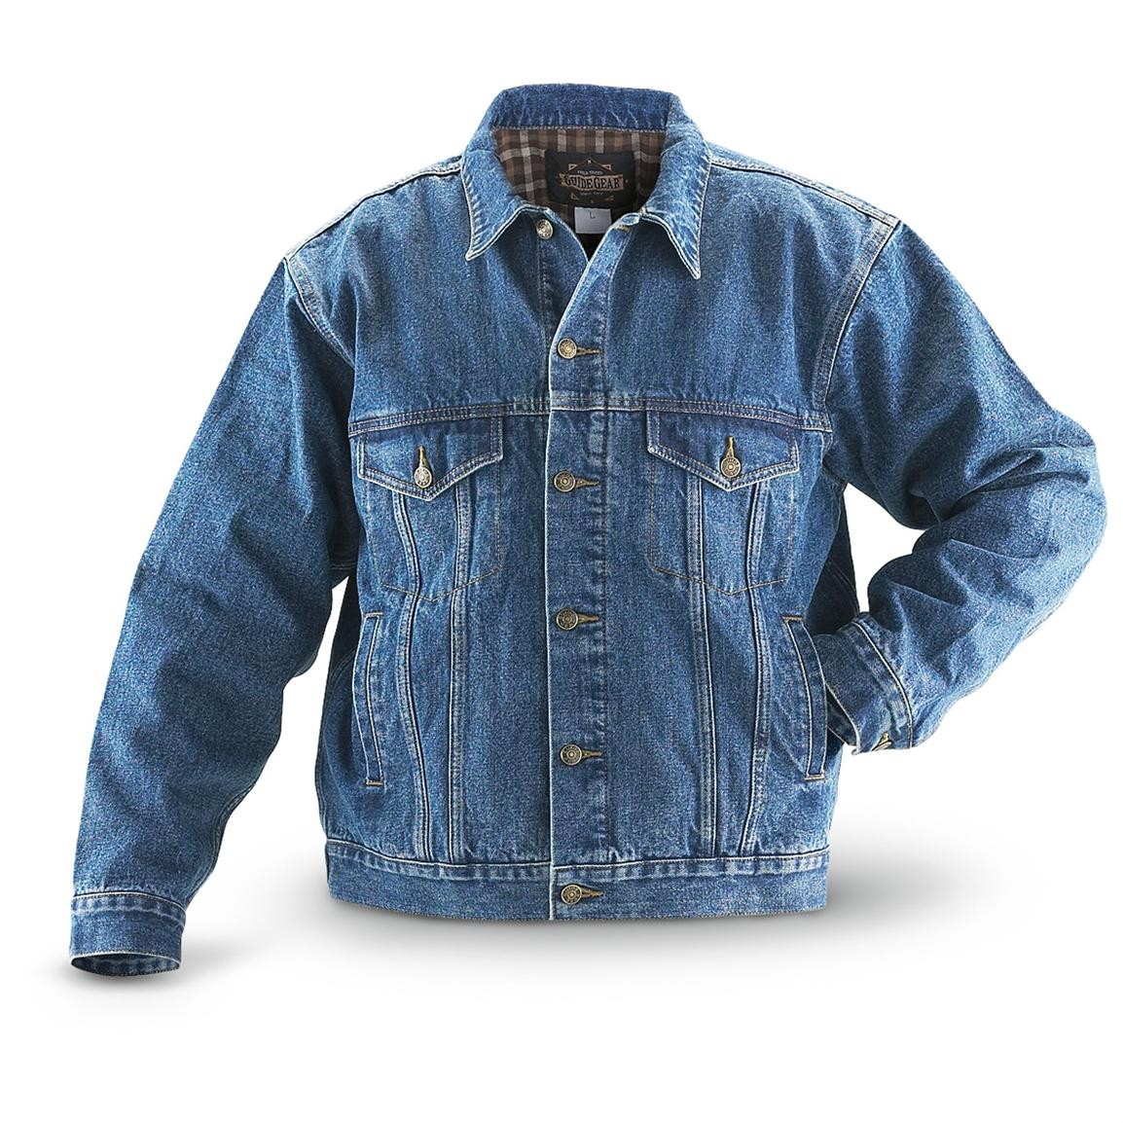
I want ( to get ) …
  a winter coat
  /kot/ US
  /kəʊt/ UK
  a jeans jacket / ‘jæk ɪt /
  a leather jacket
  a denim jacket

Slide 10
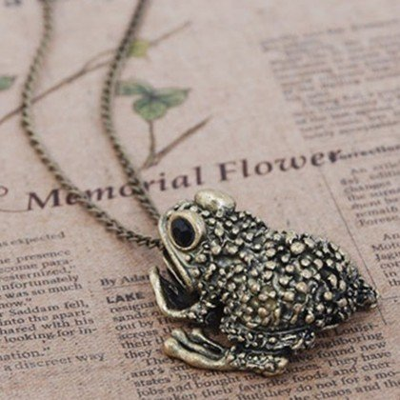
I would like ( to get ) …
  a frog necklace / ’nek lɪs /
  a frog bracelet / ’breɪs lɪt /
  a frog ring
  a frog collar

Slide 11
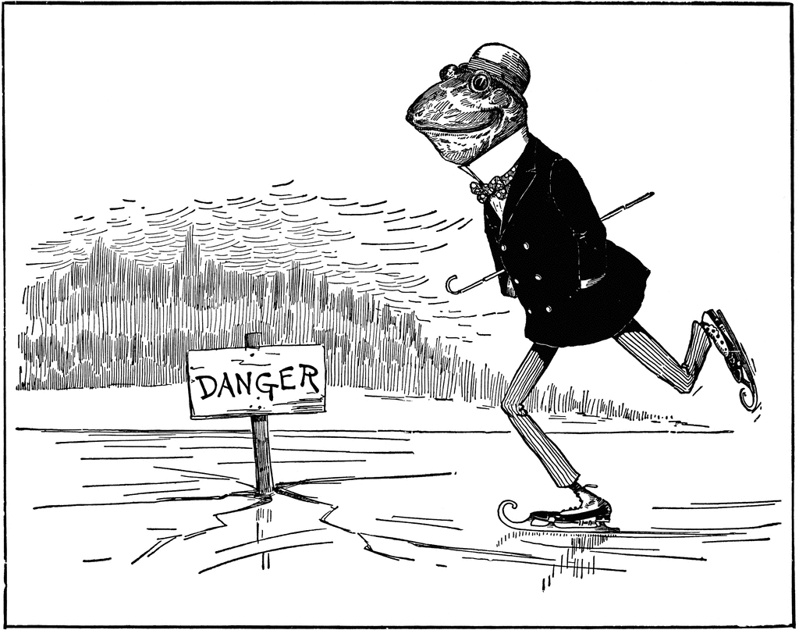
What’s he wearing ?
He’s wearing …
i _ _ s k _ _ _ s
g l _ _ _ e s
a h _ _ and a c _ _ t
striped t r _ _ s e r s
a polka-dot bow - t _ _
a turned-up c o l _ _ _

Slide 12
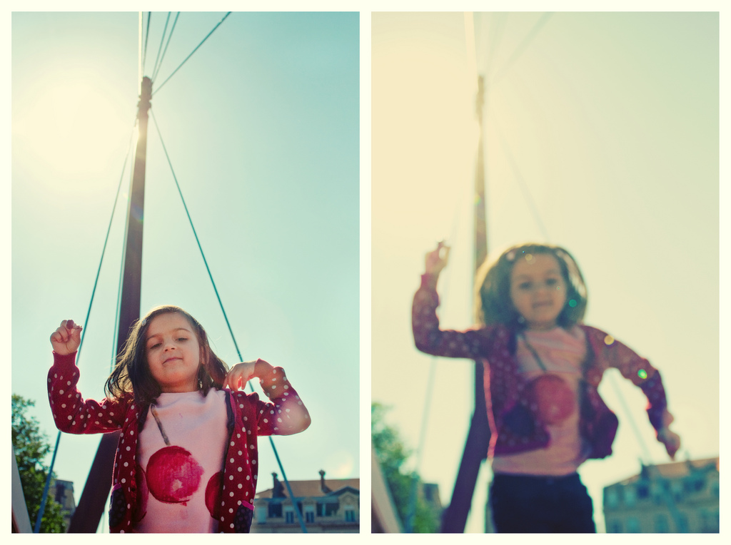
She’s j _ _ _ i n g on a bridge.
She’s wearing a polka – dot j _ _ _ e r.
What else is she wearing?

Slide 13
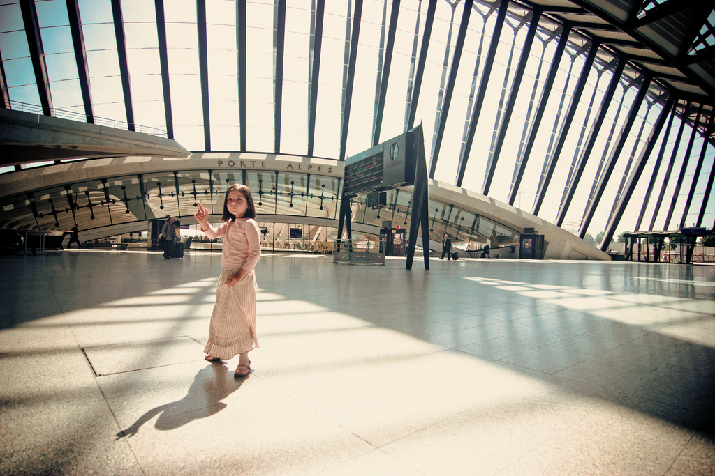
She’s wearing
a
l o n g – s l _ _ v _
s _ i r t ,
a long beige
s _ i r t ,
and
p i n k s h _ _ s
She’s wearing
a
l o n g – s l e e v e
s h i r t ,
a long beige
s k i r t ,
and
p i n k s h o e s
(pink stockings too)

Slide 14
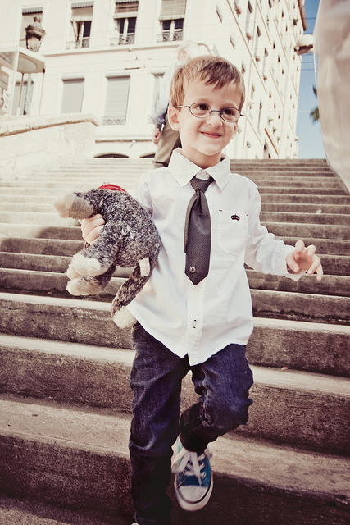

What’s he Wearing?
he’s Wearing…
a gray t _ _
a white s _ _ _ _ with a c o l _ _ _
blue t r _ _ _ _ _ _ (shoes)
&
blue j _ _ _ s and g l _ _ _ _ _
a gray t i e
a white s h i r t with a c o l l a r
blue t r a i n e r s (shoes)
&
blue j e a n s and g l a s s e s

Slide 15
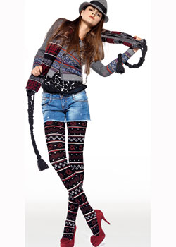
Is she wearing glasses?
No, she isn’t (wearing glasses).
Is she wearing trainers?
No, she’s wearing fancy red heels.
What is she wearing?
She’s wearing …
The quality box
long, tall
striped, colorful, print
blue, ... wool, denim, felt
tight -- closely fit, serré
short -- not long
top
1. s t r i p e s 2. a h a t
3. s h o r t s 4. a s c a r f
5. a black print t o p 6. h e e l s
7. a g r a y f e l t ha t 8. l i p s t i c k
9 Striped stockings 10. wool tights

Slide 16
The quality box
long, tall
striped, colorful, print
blue, ... wool, denim, felt
tight -- closely fit, serré
short -- not long
top
She’s wearing ...
l i p s _ i c k & h e e l s
s h o r _ s & s _ r i p e s
a b l a c k p r i n _ _ o p,
&
a g r a y f e l _ f e d o r a.
red & black
blue & gray
G o _ y o u r s c a r f o n ?
Ok, le_’ s go.

Slide 17
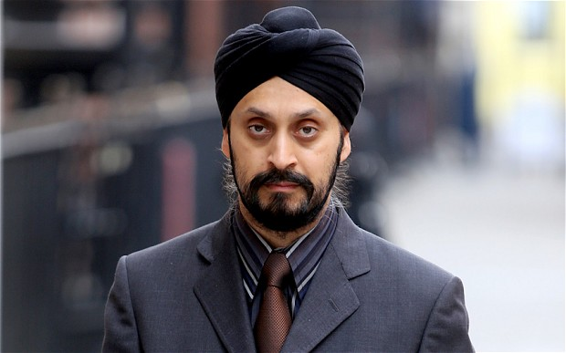
a Sikh in a s _ _ t , with a b r_ _ n tie and a b l a _ _ turban.
si:k
su:t

Slide 18
a Sikh in a s u i t , with a b r o w n tie and a b l a c k turban.
si:k
su:t

Slide 19
Wear / wearing
Wear
Never, rarely, sometimes, often, always
can
want to
need to
Wearing
be
am, is, are
was, were
like(s)

